Slide 1
Simple security system using Arduino and sensors
Group 4
Under supervision of: Dr. Mostafa Elhosiny / Eng. Mohamed Reda

Slide 2
Index
Idea of our project
Sensors used
LabVIEW & Arduino
Conclusion
Applying to other applications

Slide 3
Idea of our project
Our main goal of our project is to build a security system which detects anyone entered and create a warning, Indicates the temperature, and try to remove smoke and gas from the place.

Slide 4
Sensors used
PIR for motion detection (detects who entered)
LM-35 for temperature detection
MQ-2 to read gas and use motor to remove it

Slide 5
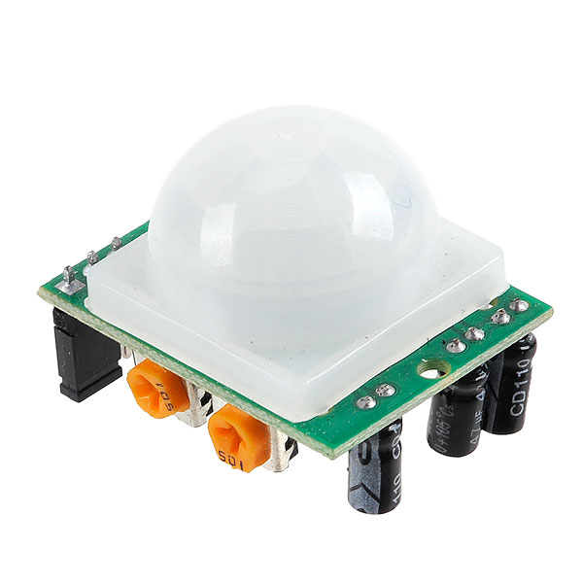
PIR
passive infrared sensor
A PIR-based motion detector is used to sense movement of people, animals, or other objects.
Sensitivity range: up to 20 feet (6 meters) 110° x 70° detection range
Power supply: 5V-12V input voltage for most modules

Slide 6
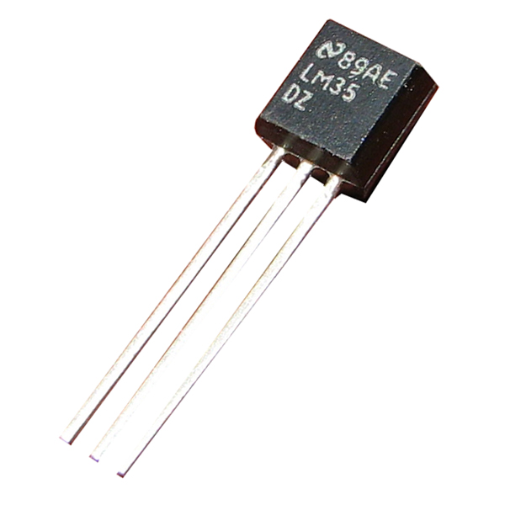
LM-35
precision integrated-circuit temperature devices with an output voltage linearly-proportional to the Centigrade temperature.
Range: -20 – 150 / -40 – 110
Voltage(min/max): 4 / 30 v
Analog output

Slide 7
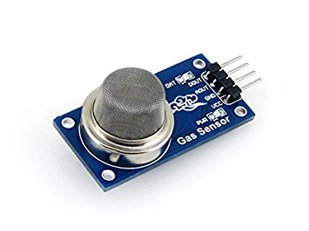
MQ-2
Gas Sensor(MQ2) module is useful for gas leakage detection
It is suitable for detecting H2, LPG, CH4, CO, Alcohol, Smoke or Propan9e.
Voltage(min/max): 4.9 / 5.1

Slide 8
Arduino and labVIEW
We used Arduino to read from the sensors and control the output to make a security system.
LabVIEW is an instrumentation program to simulate projects.
We added the Arduino library to LabVIEW and read the sensors and we created an interface to communicate between the Arduino and computer.

Slide 9
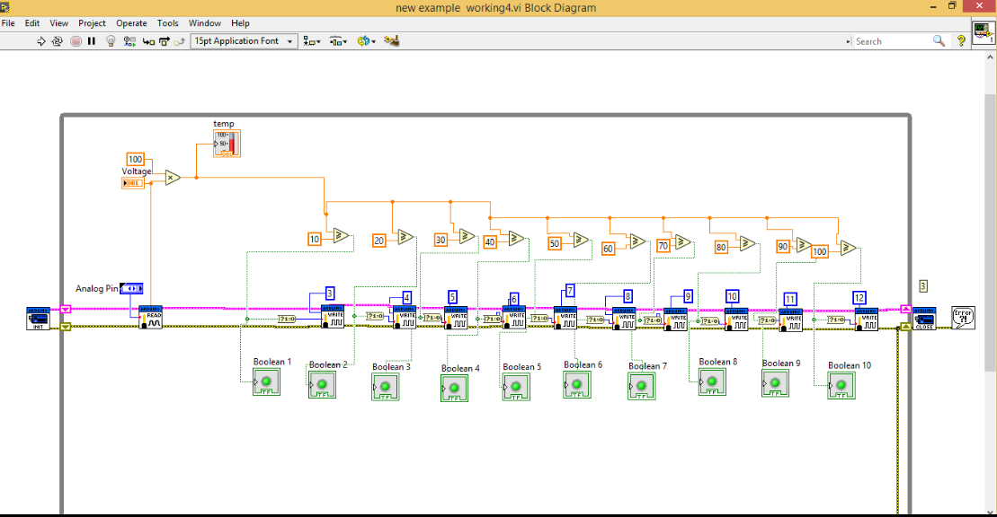

Slide 10
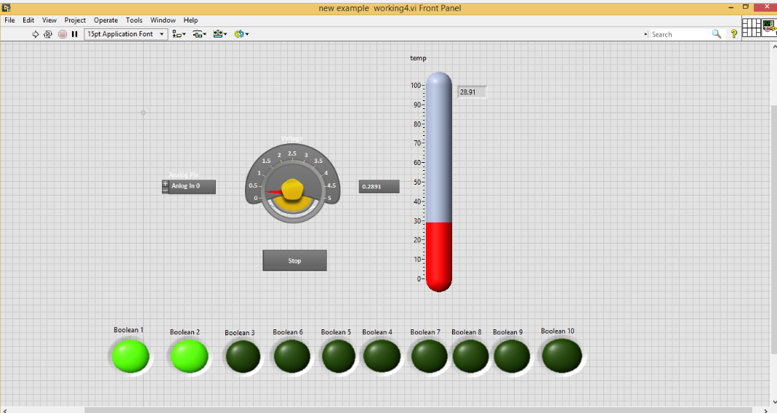

Slide 11
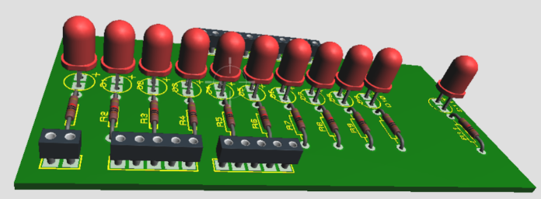
PCB simulation

Slide 12
Conclusion
Sensors is our system’s eyes to the environment
Arduino is the brain of the system (controller)
System outputs to achieve what we desire

Slide 13
Other apps.
Boiler
Air conditioning system
Hospital, ….etc.

